Slide 1
How to create or fix your Built Asset Register
Notes:
Hi everyone, thanks for joining us today to learn how to create or fix a built asset register.
My name is James Weber, and I work in the marketing team at SFG20.
I’m joined today by SFG20 Expert Davy Clark, who will be helping us understand how to create or fix a Built Asset register.
Davy works in the Professional services team at SFG20, helping our clients understand, correct and work with their asset data.
So the structure of this webinar is as follows:
First we will talk you through how to create or fix an asset register, then Davy’s going to give you a practical demonstration of what an asset register looks like and how it works.
We’ll also have a Q+A at the end of this session, so feel free to put questions in the Q&A tab as we go, you can see it on the bottom of your screen.
If there are any questions we don’t have time to answer, you’ll receive a response by email.
The webinar is being recorded, so if there is any information you like to go back and rewatch, you will be able to.

Slide 2
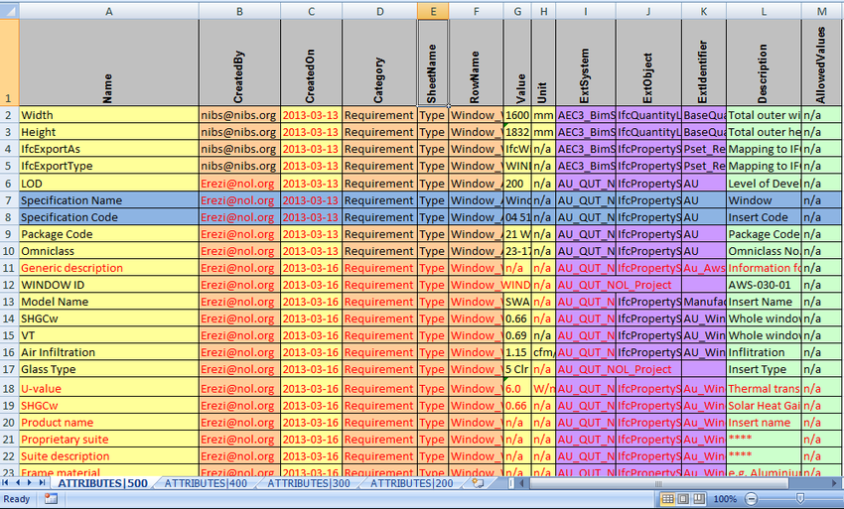
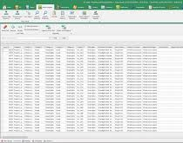
How to create or fix your Built Asset Register
What is a Built Asset Register?
Notes:
So, firstly, What is a Built Asset Register?
A built asset register provides a complete record of all assets within a building.
It can take many forms, it can be held within a Facilities Management Software System, often in COBie or MS Excel file format.
Built asset registers typically form part of a building owner’s manual or an operation and maintenance (O&M) manual.
There is no statutory requirement for this manual, but it should form a legal obligation within the contracts to construct the building.
Ideally, the Asset Register is passed across to the Operations and Maintenance team after handover by the building owner, but this does not always happen.
Which leads to the reason we are all here today… ☺

Slide 3
How to create or fix your Built Asset Register
The big problem with Asset data
If you don’t have a detailed and complete Asset register,
how can you maintain your Assets?
Notes:
Most asset data is incomplete, much of it is missing.
Whether it’s lost during the handover process, passed across ineffectively or just filed away somewhere and forgotten, the result is the same.
Generally, an Asset Register that’s 80% complete is considered good in Facilities Management.
This makes working with Asset Registers frustrating at best and impossible at worst.
In fact, 93% of FM professionals admitted they had had a frustrating experience working with Asset Registers at a recent SFG20 poll.
So, what are the consequences of poor asset data?
Put simply: poor asset data makes it hard to maintain your assets.
Lack of asset data could affect you in a variety of ways, but here are a few examples.
You might struggle to understand what assets you have, where they might be located or how old they are.
Just these 3 examples are critical to how you would structure and carry out a maintenance plan.
If you can’t maintain your assets, you are exposing yourself to serious legal, commercial, and contractual risk.
These risks can result in serious repercussions that can and do land individuals in court, prison, expose companies to regulatory fines, and damage reputations.
And even if we just set aside the risk for a moment, think about the cost.
As you may be aware, the cost of maintenance across the course of a building's working lifespan is far higher than the initial cost of construction.
If you are maintaining assets ineffectively or not at all because you don’t have good asset data, you are setting yourself up for major long-term costs and operational downtime.
These costs are incurred where assets require repair or replacement more frequently.
Inefficient assets often consume more energy as well, making it harder for you to reduce your carbon footprint and meet your energy saving goals.

Slide 4


How to create or fix your Built Asset Register
+
Assets =
Notes:
If you know anything about SFG20, then you know that we are the Industry Standard for Building Maintenance.
SFG20 created and maintains a library of more than 1500 asset-specific maintenance schedules, that align with the latest legislation, regulations, standards and codes of best practise
Each schedule is made up of multiple asset-specific tasks that tell you what to do, when to do it, how long it should take, and the skillset required.
SFG20 essentially supplies you with compliant PPM, that also helps you secure and save time and money, in some cases this can add up to Millions of pounds.
The time and cost savings aren’t the focus of today’s webinar, but if you would like to know more, please vote in the poll that will pop up onscreen in a second, and we’ll send you further resources after the webinar on how that’s possible.
So let’s continue talking about why SFG20 is helping you with your asset data.
Some of our customers were experiencing a problem we hadn’t anticipated: they loved the SFG20 library, but their asset data was so poor, that they were struggling to actually apply SFG20 content to it.
This meant that they were failing to create a practical maintenance strategy that would benefit their estate.
We realised we needed to take a step back, and help these customers create a workable Asset Register.
That’s part of the reason why SFG20’s Professional Services team was created.
SFG20 experts like Davy here work with you to correct your Asset Register, which gives you the foundation on which to build a workable maintenance strategy.
So that’s what today’s Webinar is all about.
Davy is going to take you through some practical steps to create or fix your Asset Register that you can action in your operation.

Slide 5
How to create or fix your Built Asset Register
Information to include in an Asset Register
Description and identification number
Barcode or Serial Number of assets
Purchase information (price, date, order number)
Location within the building
Size and specifications
Maintenance requirements and intervals
Supplier and installer details
Current value and condition
Efficiency and energy usage
Health and safety information
Insurance information
Warranties and service level agreements
The remaining life of the asset
Estimated Resale Value (Salvage Value) of the asset
Notes:
DAVY:
Now the first thing you need to know is that creating or fixing a Built Asset Register are very similar processes.
The only major difference is that creating an asset register from scratch will virtually always require an asset capture survey.
An asset capture survey means going through your estate and physically locating and identifying every Built Asset you have.
You can do this yourself or hire an asset survey company to do it for you.
The easiest way to think about what data you need to collect is to consider what questions you need to answer when the execution team or the board ask you about the estate. For example:
Are we compliant?
Can we make the estate more energy efficient?
How can we reduce the operational cost of running the estate?
What are the levels of carbon emissions emitted from our estate?
To answer these common questions, you will need to collect the information shown on screen for each asset:

Slide 6

How to create or fix your Built Asset Register
How to categorise your Asset data
Asset type
Asset value
Asset risk
Asset
ownership
Asset
lifecycle
Department
or business
unit
Physical
location
Asset type
or category
Criticality to business operation
Notes:
Now that you’re clearer on your built asset register’s data structure, you’ll need to identify the asset categories and subcategories that are relevant to your organisation.
Some examples are shown onscreen

Slide 7

How to create or fix your Built Asset Register
Buildings
Mechanical
Electrical
Structure
Heating system
Electrical system
External Fabric
Steam system
Telecommunications
Roof
Ventilation system
Alarms and detection systems
Internal Fabric
Piped medical gases and vacuum pumps
Fixed plant
Internal Fittings and
Fixtures
Hot and cold water
systems
Building management control system
External Works – Grounds And Gardens
Lifts and hoists
Drainage and Sewage
and Water Supply
Boilers and calorifiers
Fixed plant and equipment
Fuel storage and
distribution
Notes:
You should also create a simple classification system to make it easier to find assets within your register.
You may wish to group assets together in systems such as Building, Mechanical and Electrical as shown here

Slide 8

How to create or fix your Built Asset Register
Heating Systems
Ventilation Systems
Distribution
Ventilation plant
Surfaces
Ductwork
Controls
Controls
Pumps
Refrigeration
Insulation
Cooling towers
Compressors
Insulation
Notes:
Within these systems, you can group assets into components as seen here and then into sub-components as seen here.
You should establish unique asset codes too, because this will help you find or track individual assets quickly and easily.
It’s important to select an appropriate data storage format where information can be secured, managed, easily retrieved as well as archived or disposed of where necessary.
For ease of access, communication, auditing, and updating, we recommend housing all of your collected data digitally such as through BIM (Building Information Management), AIM (Asset Information Management) or CAFM (Computer Aided Facility Management) software.
XLS and CoBie are also common.
Special consideration should be given to data ownership – this should always remain with the building owner no matter how or where the data is stored.
If you hired a facilities service provider or contractor to conduct an asset capture survey make sure that your building asset register can be recovered intact (preferably at zero cost) when contractual relations cease.

Slide 9

Notes:
Note this is just one example tag id might be different etc

Slide 10



How to create or fix your Built Asset Register
How can SFG20 help?
Notes:
JAMES
Thanks for that Davy, now before we move onto the Q & A there’s something I need to address.
I won’t lie, building or fixing an Asset Register, is no small task.
It might be feasible for those of you with smaller estates, but if you have thousands or tens of thousands of assets, its going to be a tough ask.
So yes, if you’ve sat through this thinking, “oh my goodness, how am I ever supposed to do this”, don’t worry, we can help you.
Davy and other members of the Professional Services team can help you make sense of your asset information, as well as help you improve an asset register if you have existing data.
The other big advantage of working with SFG20s professional services team directly is that once we’ve helped you to improve your asset data we can help you assimilate that data into Facilities-iQ.
Facilities-iQ is SFG20’s software solution, and it’s how you access the SFG20 standard.
This means that by working with us directly, not only will you get a workable Asset Register, but also a workable maintenance strategy.
You’ll get asset specific PPM that you can schedule yourself or schedule in your CAFM via our integration.
Having access to this information allows you to easily create precise specifications for tender or rapidly mobilise contracts, a major competitive advantage when creating or bidding on a Tender.
Now as I mentioned previously, access to SFG20 does secure and save a lot of time and money.
This is because the SFG20 standard helps you maximise asset lifespan, minimise repair costs, hit energy saving targets and reduce CO2 emissions.
It can easily save you hundreds of man hours per year in PPM creation and compliance benchmarking.
It can help you forecast task timings and headcount requirements, reduce unplanned downtime and much more.
All this saves you a ton of money, I’ve heard as much as £2m from an NHS client.
I actually had a customer from Saudi Arabia tell me last week that they wouldn’t even use SFG20 if it didn’t provide such good return on investment, because in Saudi Arabia, they aren’t held to the same compliance standards as the UK.
I also had a customer tell me that the standard is incredibly useful in the public sector, because it helps you to secure maintenance revenue.
They were able to secure an additional £1 million to their budget by using the SFG20 standard to justify what they were legally required to maintain.
So, if any of that sounds good to you, please vote in the following poll, and you’ll be contacted by an SFG20 expert accordingly
[POLL]
If you would like to consult with us about your asset data and learn more about how SFG20 can benefit you, please select the first option.
If you only want help with fixing your asset data, vote for option 2.
If you just want to learn more about SFG20 it’s option 3.
I’ll give you all 30 seconds to vote on that and then we will move on to the q+a.
I’m also going to leave this poll open in case any of you change your mind during the Q+A
Alright so lets get into the Q+ A…
Ok that will do it for the Q+A,
We will leave the webinar going for another 5 minutes, so if you have any more questions, please leave them in Q & A and we will get them answered.
The poll will stay open too.
Thank you everyone for coming and I hope you found that helpful!

